Slide 1

Year 1 and 2
Parent Information Meeting
Welcome & Introduction
Miss Lightfoot and Miss Rigg P2.
Mrs Smith and Miss Cowan P1.

Slide 2

Finding out about...
Our timetable, (playtimes, assemblies).
BDS Curriculum Drivers
What are we learning this year
Marking & Handwriting
(RWI Scheme)
Behaviour Policy
Interventions and Assessments
Seesaw and Homework
Residentials (Hawse End) & Trips
How you can help at home

Slide 3
Year 1 and Year 2 Timetable

Slide 4
Playtimes
Breaks are shared with the whole school and children can choose a fruit snack from the fruit bowl. If you choose to send in a snack, please can you make sure it is a healthy snack.
Assemblies
Whole School on Monday (collective worship)& Friday (celebration)with Mrs Fish
Tuesday – Teacher Led Worship
Class Assembly / Class worship / Picture News – Wednesday
Key Stage Assembly – Thursday

Slide 5

Following our new healthy eating guidelines please can you ensure your child has a healthy lunch box.
On your child’s birthday please refrain from bringing in cakes or sweets. Your child’s birthday will be celebrated in the classroom by wearing a birthday hat and sash. They will receive a special certificate to celebrate their important day.

Slide 6




Our Curriculum Drivers
What we are learning each half term can be found under Curriculum and each class page on the website.

Slide 8








Core Subjects
Maths: Fluency, Reasoning & Problem Solving using White Rose Maths resources.
English: Read Write Inc (Spelling, Writing, Reading and Phonics)
Science: Taught in classes on Monday afternoons.
Topics include: Everyday Materials, Seasonal Changes, Animals including Humans, Plants, Food Chains
RE: We follow the Questful scheme for R.E.

Slide 9
Read Write Inc, is a scheme which is now used in school to teach phonics and reading and incorporates writing into lessons too.
Children learn following a systematic approach, which is designed to keep children learning together.
Children use the phonic skills as well as learning ‘speedy’ words to ensure fluency in reading. They will bring home books which have been taught in school as well as a familiar book, a Book Bag book and also a reading for pleasure book.
We use ‘Fred Fingers’ to spell words and aim to give children the skills to read and write independently.

Slide 10






Foundation Subjects
Mostly taught in the afternoons.
PE (iPEP)
Music (Charanga)
Art & DT (Kapow)
PSHE (Jigsaw)
Computing
Geography and History

Slide 11

Marking Policy
1:1 Verbal Feedback in lessons (immediate)
Whole Class Feedback (summary)
Marking Code (review)

Slide 12
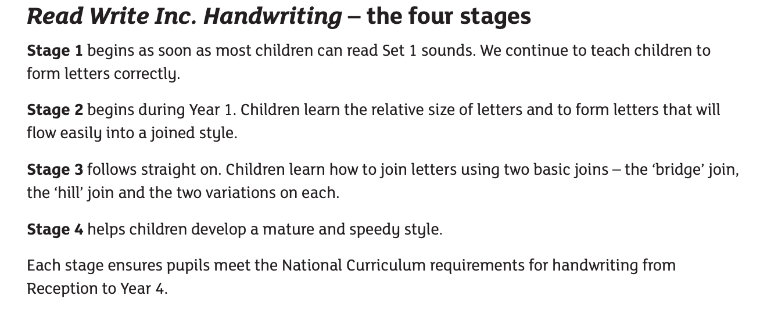
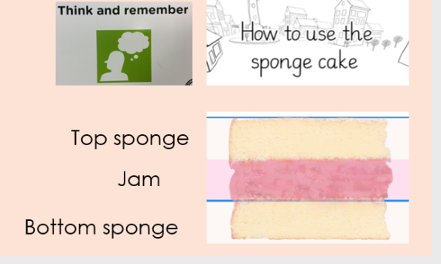
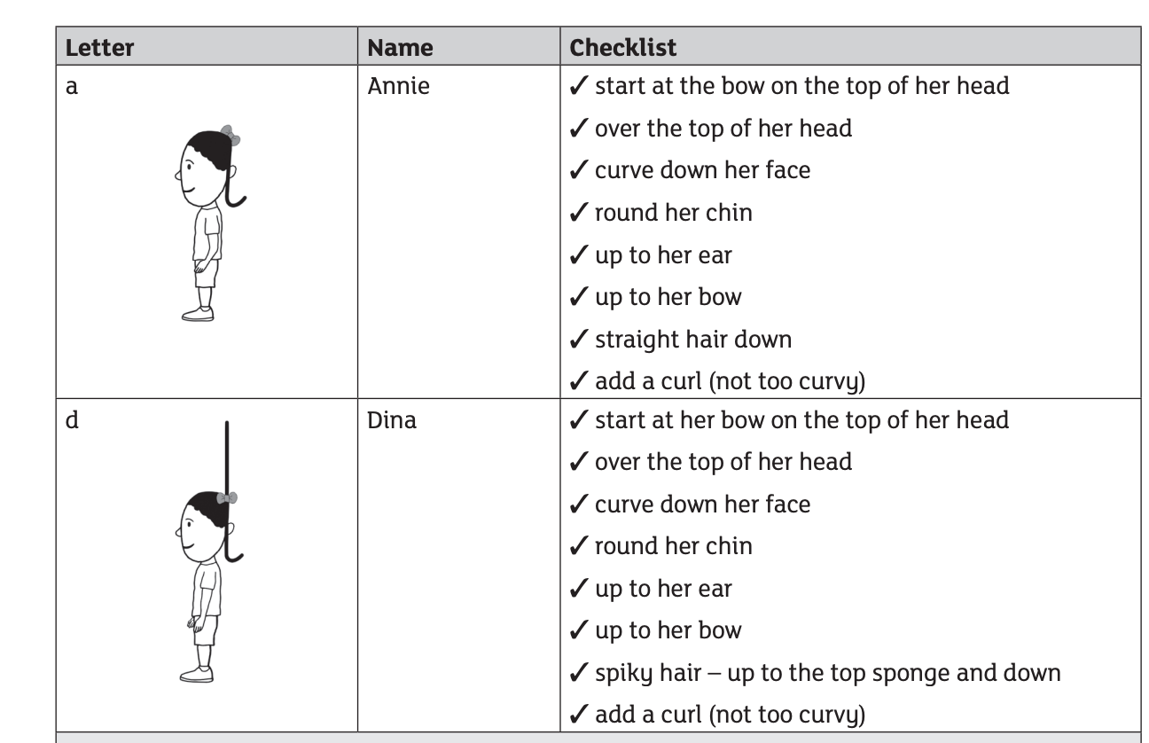
Handwriting Focus

Slide 13
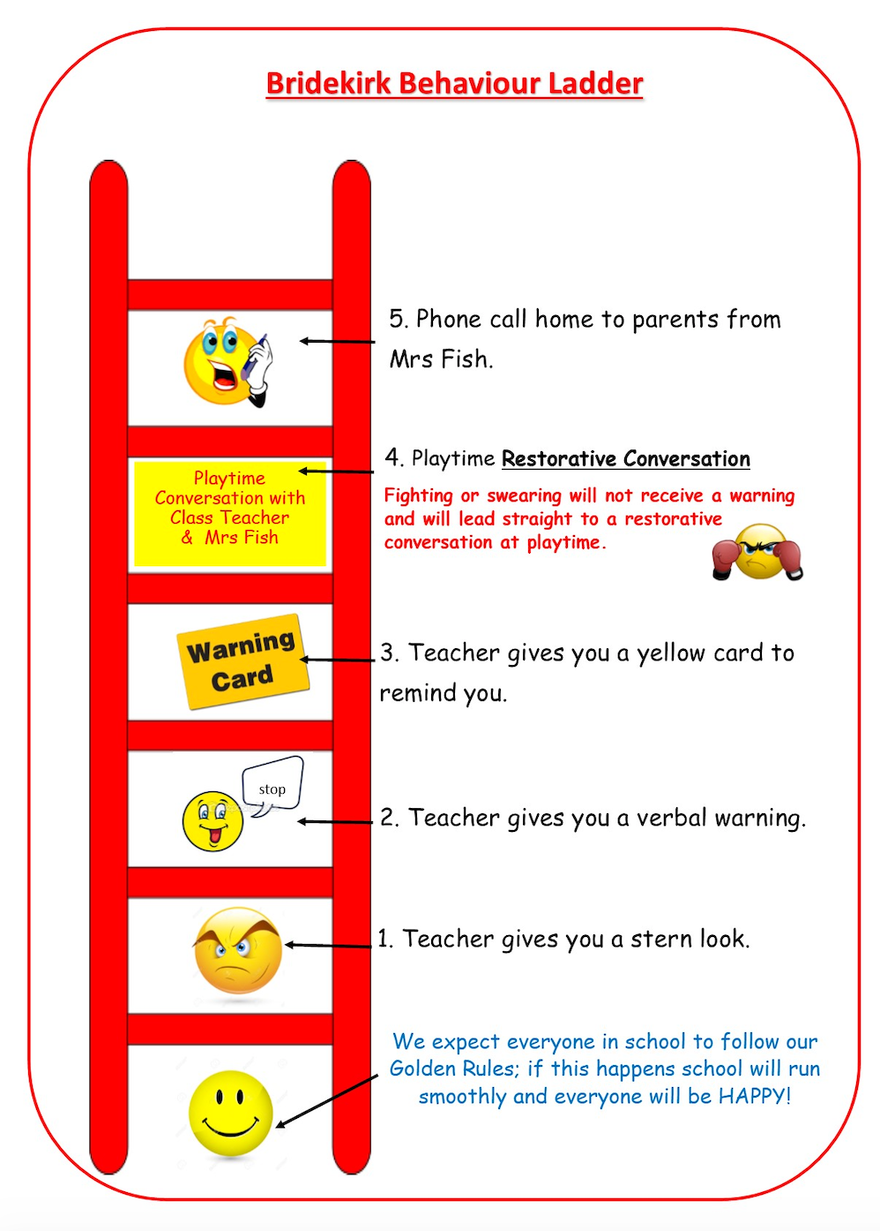

Our Behaviour Policy
School Behaviour Policy.
Golden Rules
Positive reinforcements, praise and reward stickers and team points.
Golden children in assembly each Friday… Jumpers

Slide 14
Wonderful
Walking
Marvellous
Manners
Terrific
Transitions

Slide 15

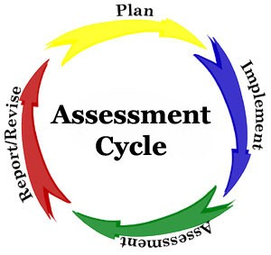
Interventions
Throughout the school we identify children who we feel would benefit from small group work, extra practice, reinforcement, pre-teaching, specific focused activities, etc. Most children will benefit from one of these groups at some point during their time at Bridekirk School, and need your support at home as well.
Assessments
Teachers continually assess children so that they are able to plan the next lesson. At the beginning of the
year and towards the end of each term a formal
assessment is carried out to check progress and
attainment.Yr1 Phonics Screening in June.

Slide 16

Seesaw and Homework
Seesaw in school is used for homework which will be set each week.
Y1 and Y2 will be given either a maths or English activity each week.
Please use the Parent app to message staff directly. Anything urgent after 6pm should be emailed to: admin@bridekirkdovenby.cumbria.sch.uk

Slide 17
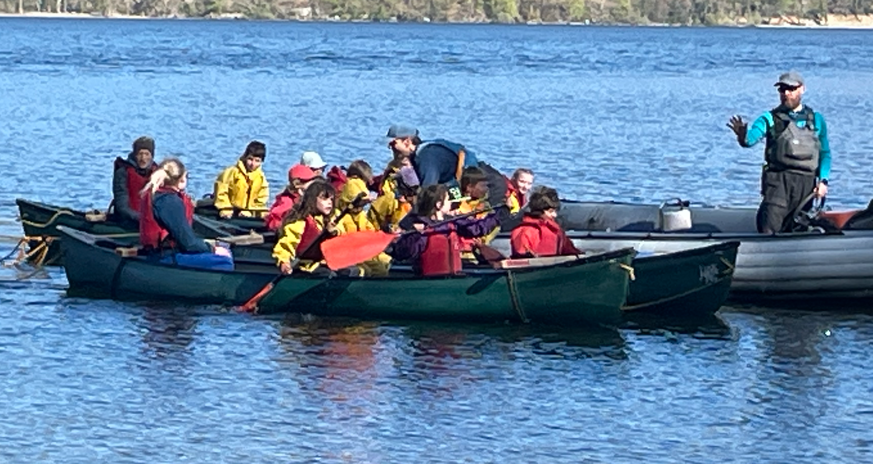
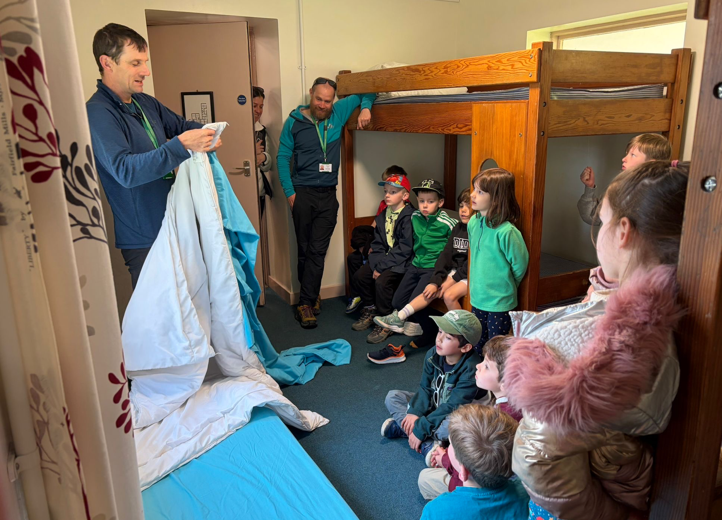
Residentials & Trips
Year 2 - Outdoor Residential, Hawes End
Date TBC.
Trips will be organised throughout the year and linked to Topics.

Slide 18

How parents can help at home.
Please label all items of clothing.
Water bottles not put in reading bags.
P.E kits to be worn on PE days (Tuesdays unless otherwise stated).
Reading – Please write in your child’s diary.
Homework – 1 piece per week
Sensible bedtimes during the school week.
Inform school office of holidays absence, lateness etc.
Inform school office if there is a change to home time arrangements.
Thank you

